Slide 1
EDA: NYC 311 Service Requests
Niki Agrawal

Slide 2
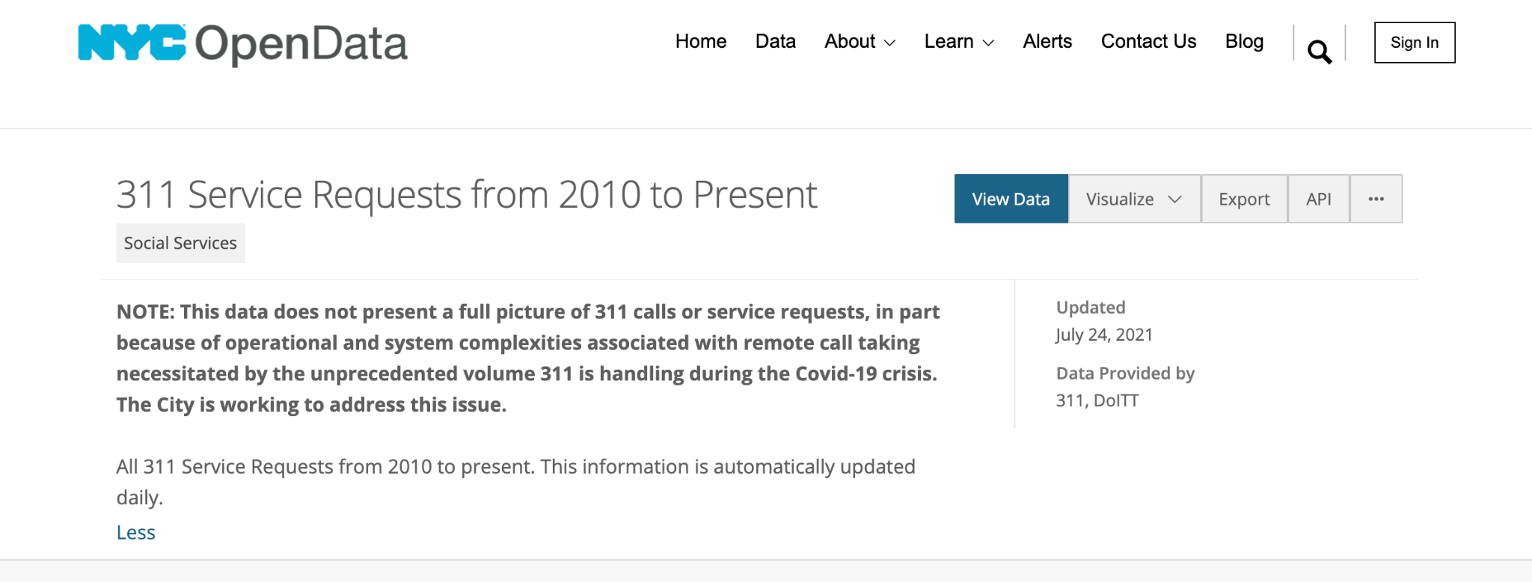
Background
NYC311’s provides the public with quick, easy access to all government services and information to address non-emergency requests.
Accepts Service Requests for a wide range of issues, including over 500 complaint types, ranging from street/sidewalk complaints to trash collection issues.
This service is available 24/7. NYC residents can call or submit requests online, after which each request is logged into a database.
NYC Open Data has made NYC’s 311 Service Request data publicly open from 2010- present.

Slide 3
Research Proposal
This study will look at a subset of data, from 2019-2021, to uncover the top categories of complaints associated with all government agencies, so that each organization can better understand the target issues in and appropriately allocate resources and funding.
Additionally, this study aims to drill down into the #1 complaint type, Noise, to identify the various subsets of noise complaints, between 2019 - 2021, and uncover any trends observed within these subsets, internally and in relation to pre-pandemic vs. pandemic time periods.

Slide 4
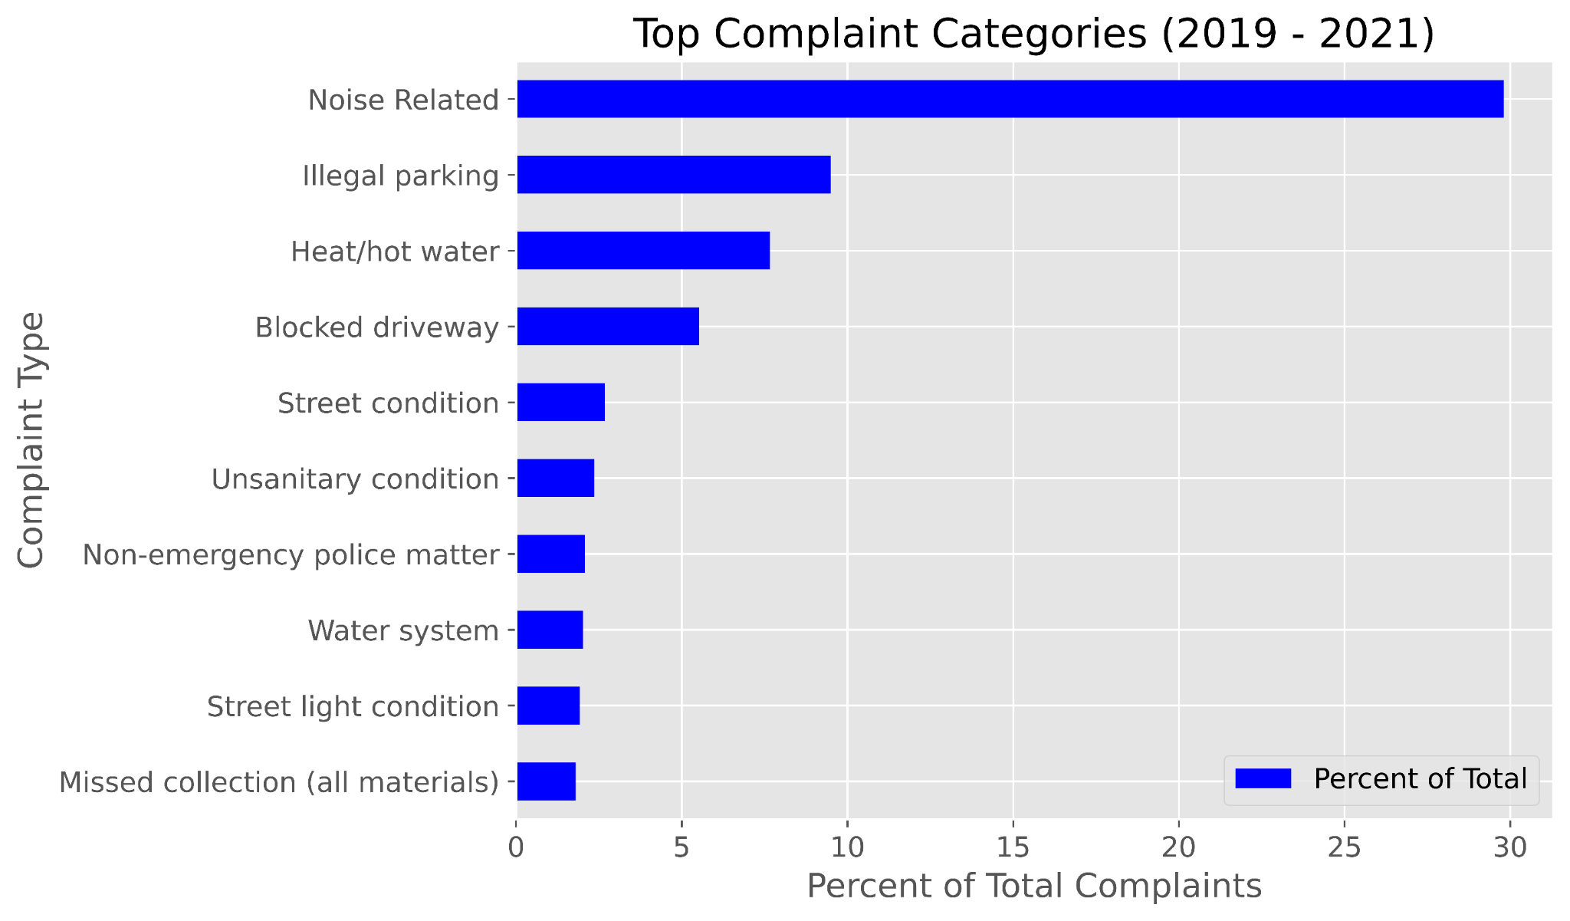
Top Complaint Categories

Slide 5
Agency Complaint Distribution
Agency: NYPD: 'New York City Police Department
Total complaints logged: 2303572
Agency | Percent of Complaints
NYPD | 49.441066
HPD | 17.316882
DOT | 8.952663
DEP | 5.833692
DSNY | 4.985590
DPR | 3.701364
DOB | 3.309110
DOHMH | 1.635958
DHS | 1.107136
DCA | 1.100762
TLC | 0.649893
EDC | 0.354458
DFTA | 0.055245
DOE | 0.037946
DOITT | 0.016054
FDNY | 0.000021
Complaint Type | Percent of Complaints
Noise Related | 55.79
Illegal parking | 19.22
Blocked driveway | 11.19
Non-emergency police matter | 4.20
Abandoned vehicle | 3.37
Illegal fireworks | 2.65
Homeless street condition | 0.69
Animal-abuse | 0.60
Traffic | 0.40
Drug activity | 0.35

Slide 6
Noise Complaints Further Analysis

Slide 7
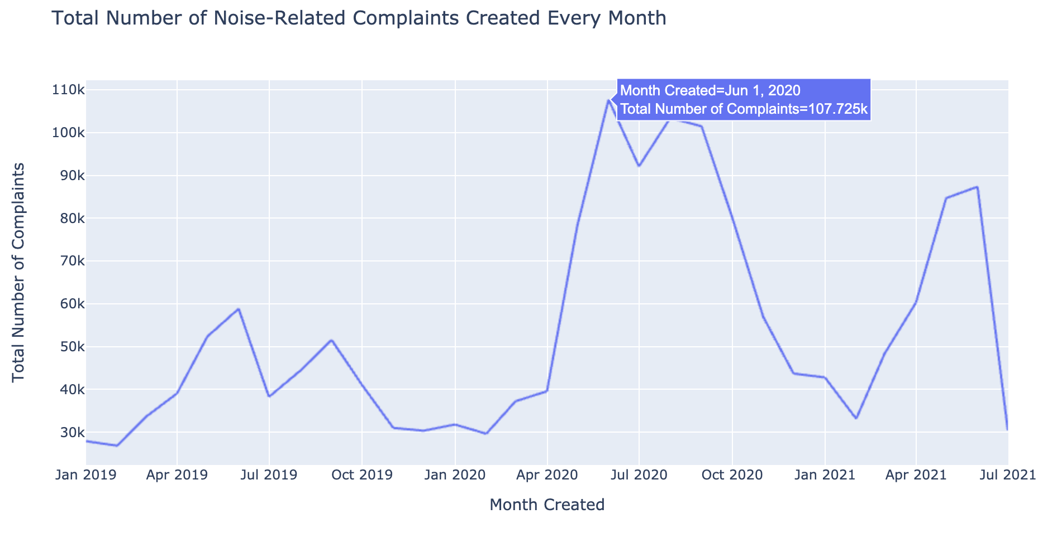

Slide 8
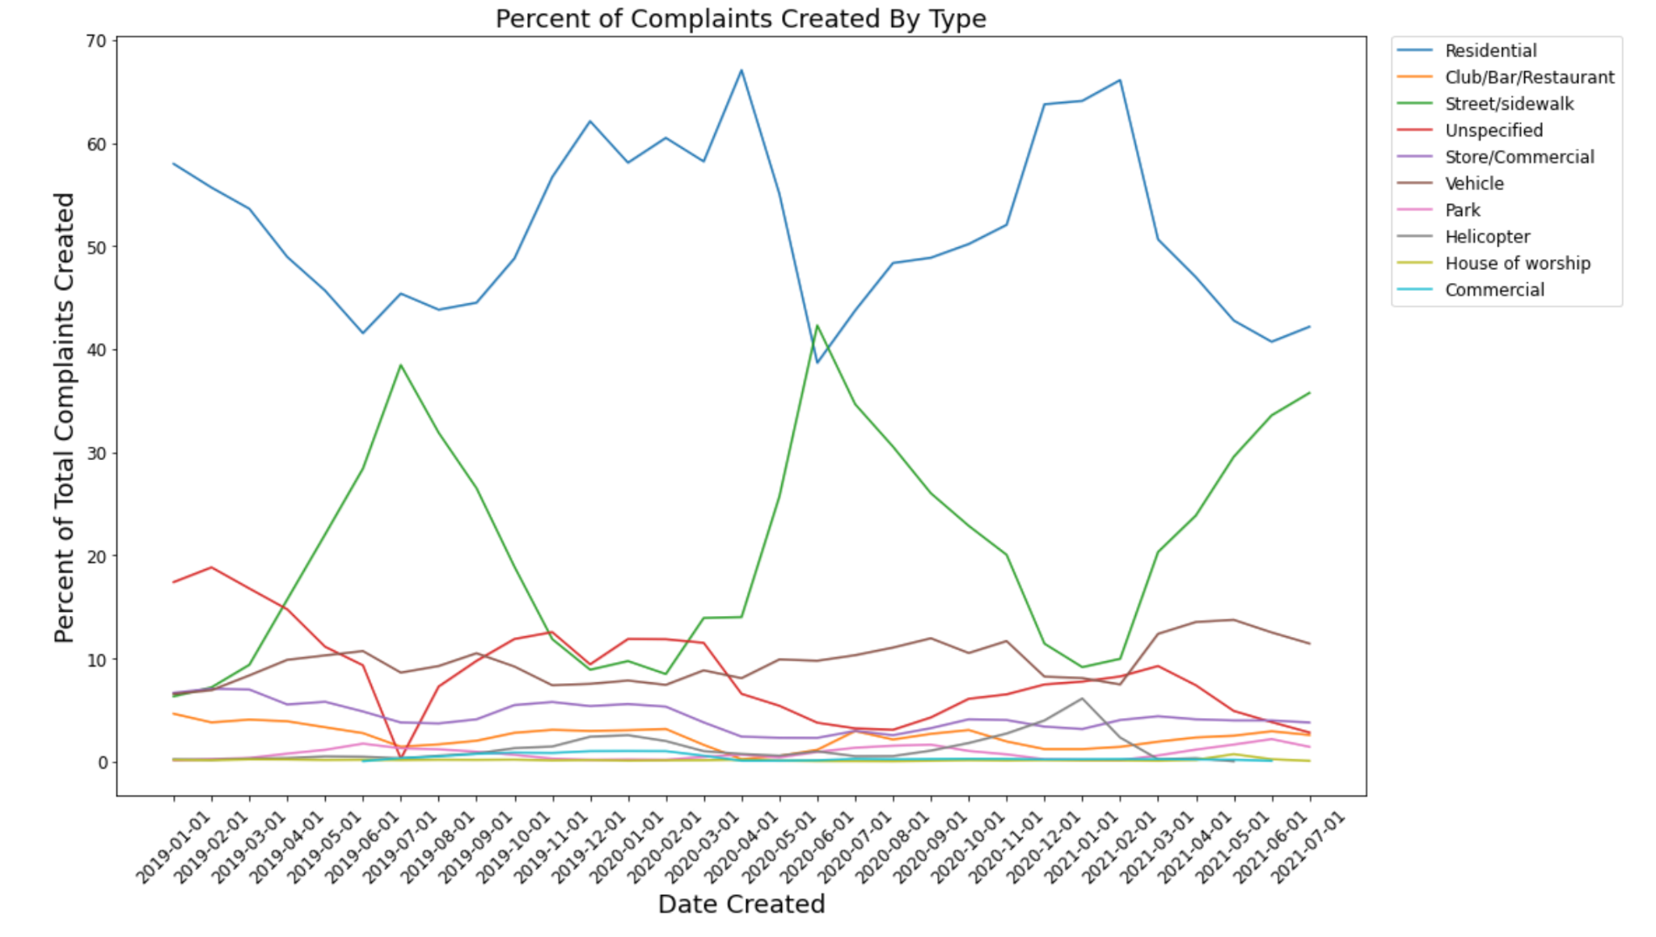

Slide 9
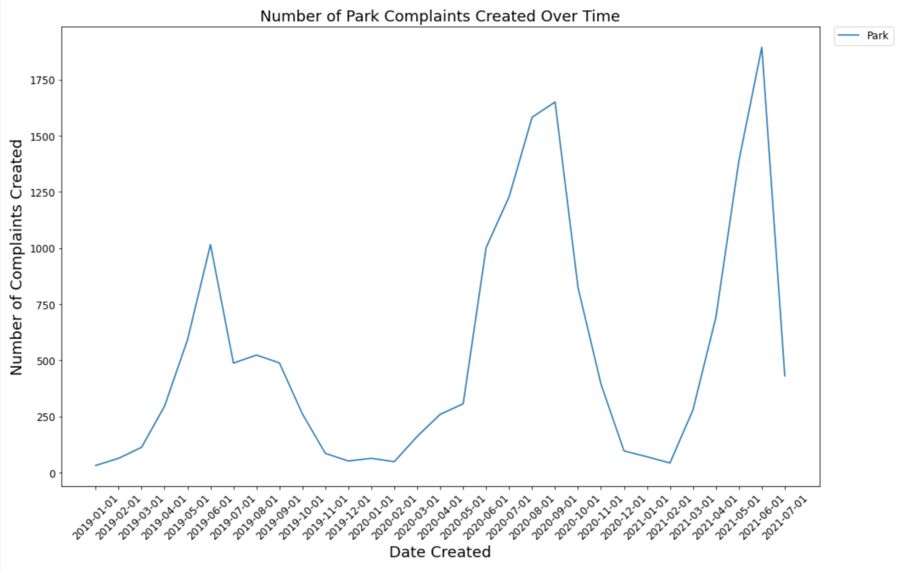
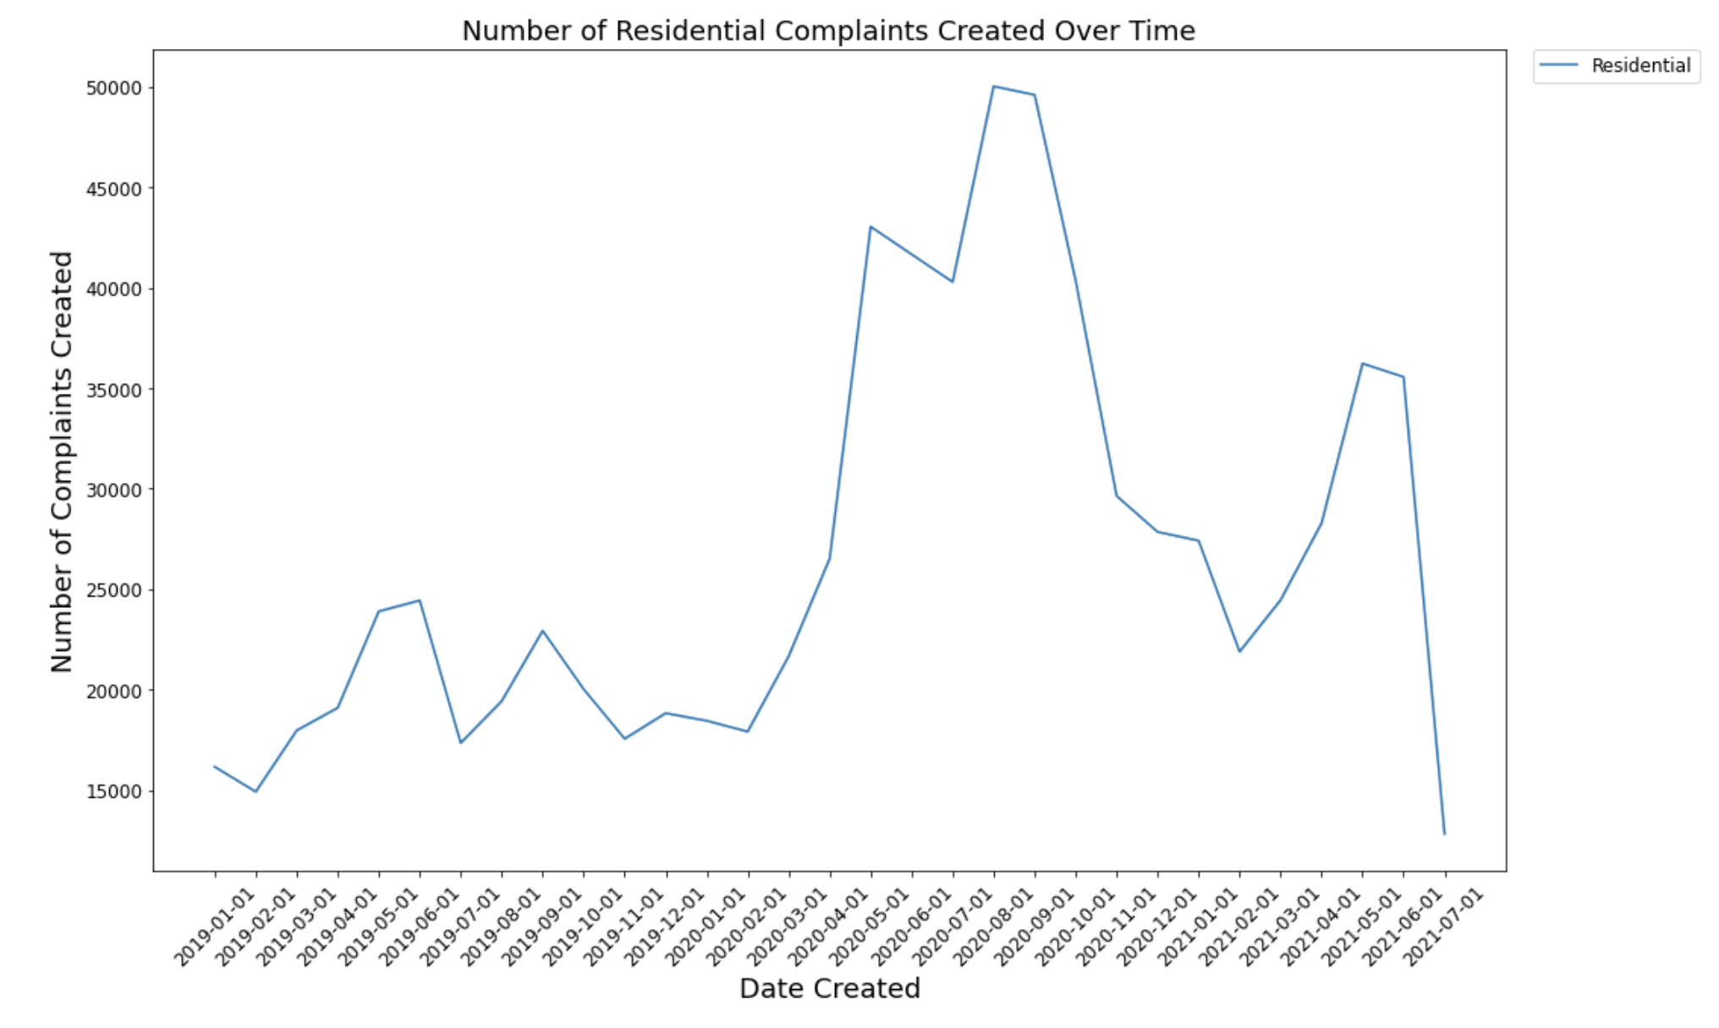
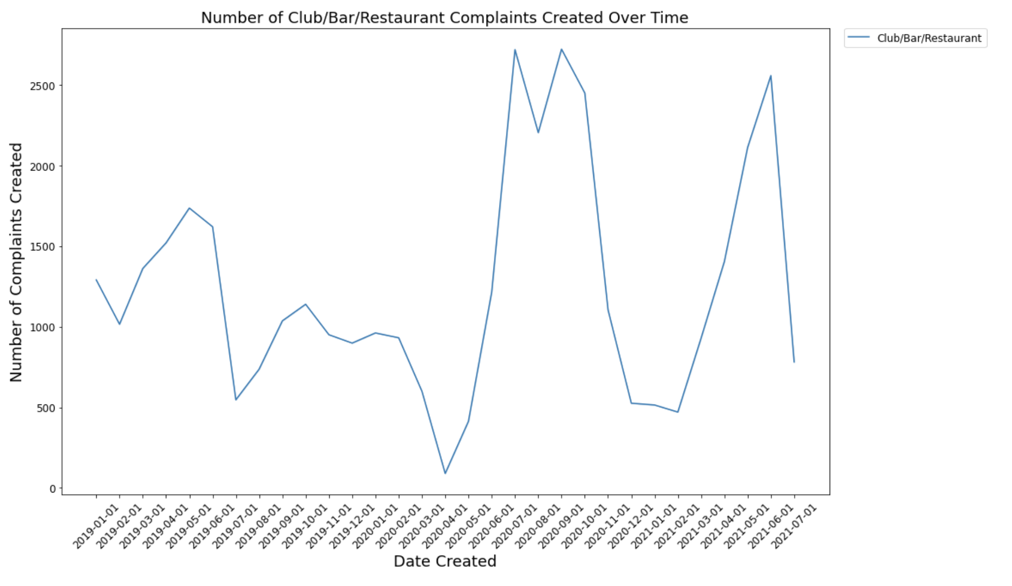
A Closer Look at Noise

Slide 10
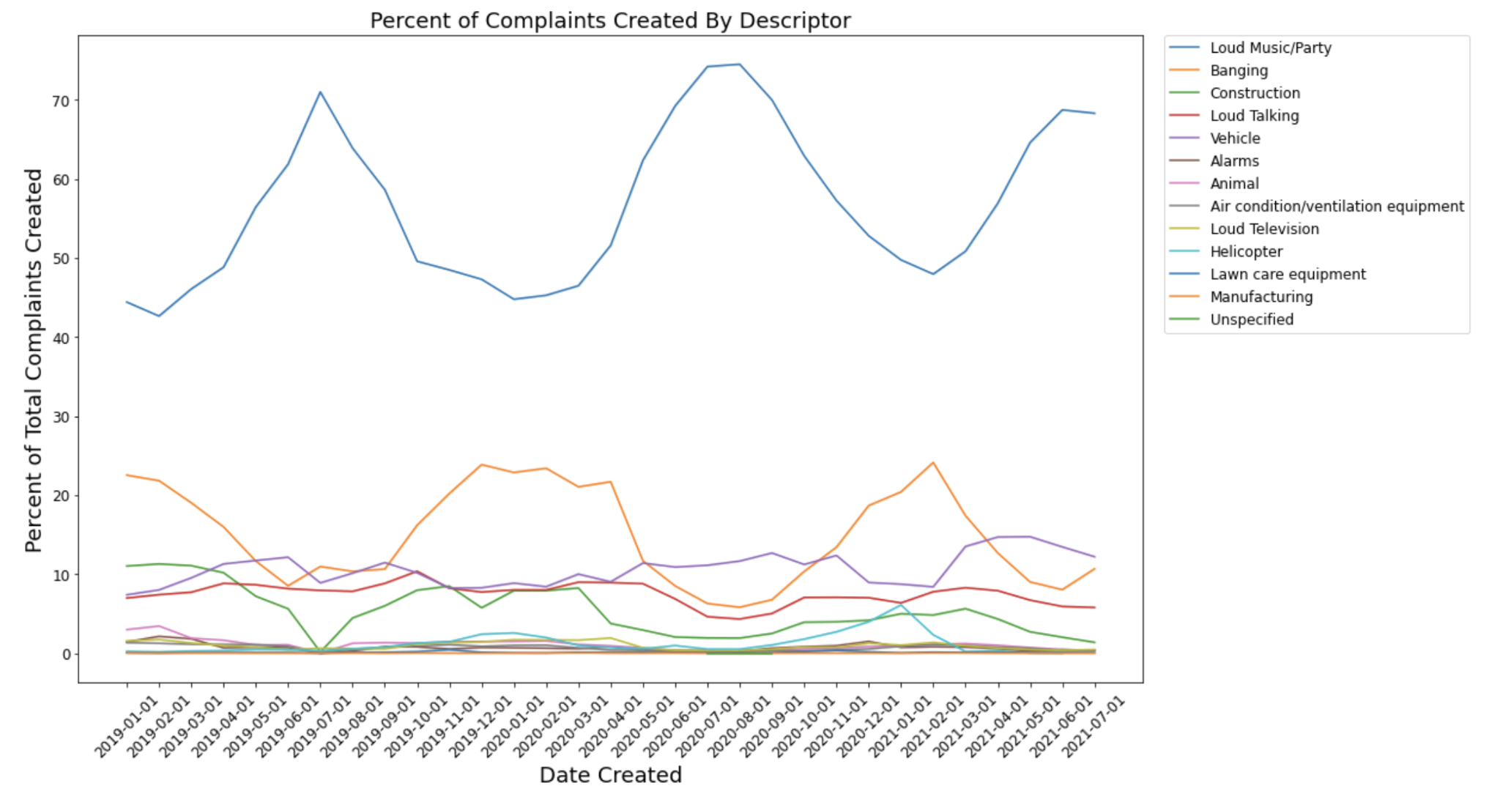

Slide 11
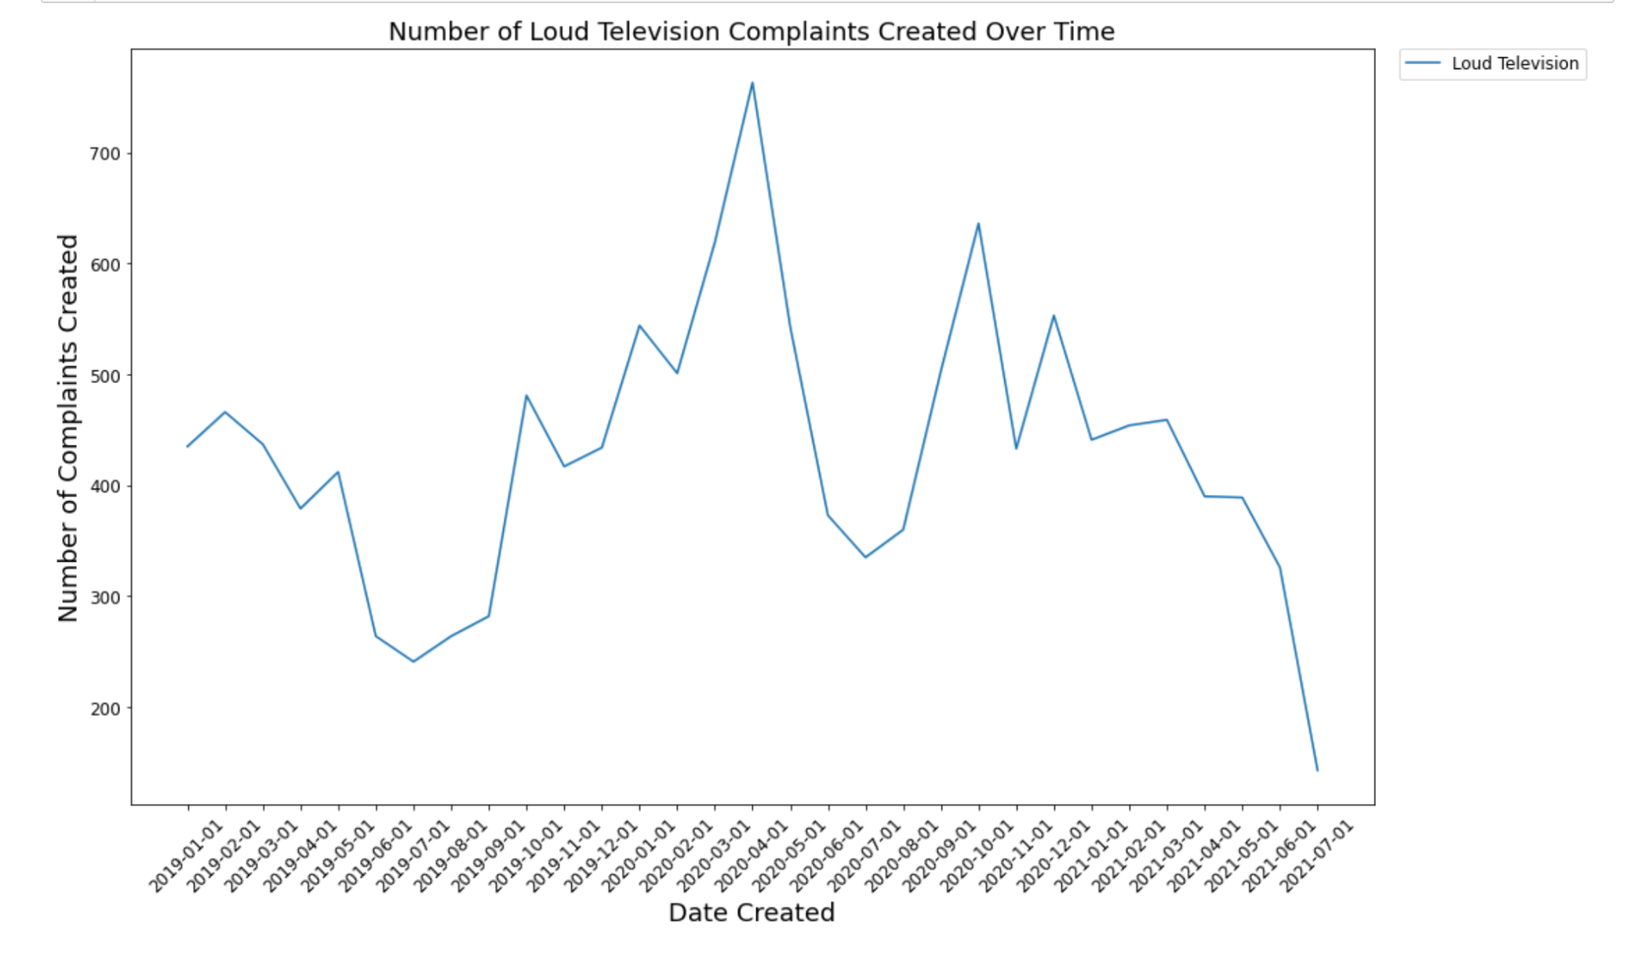
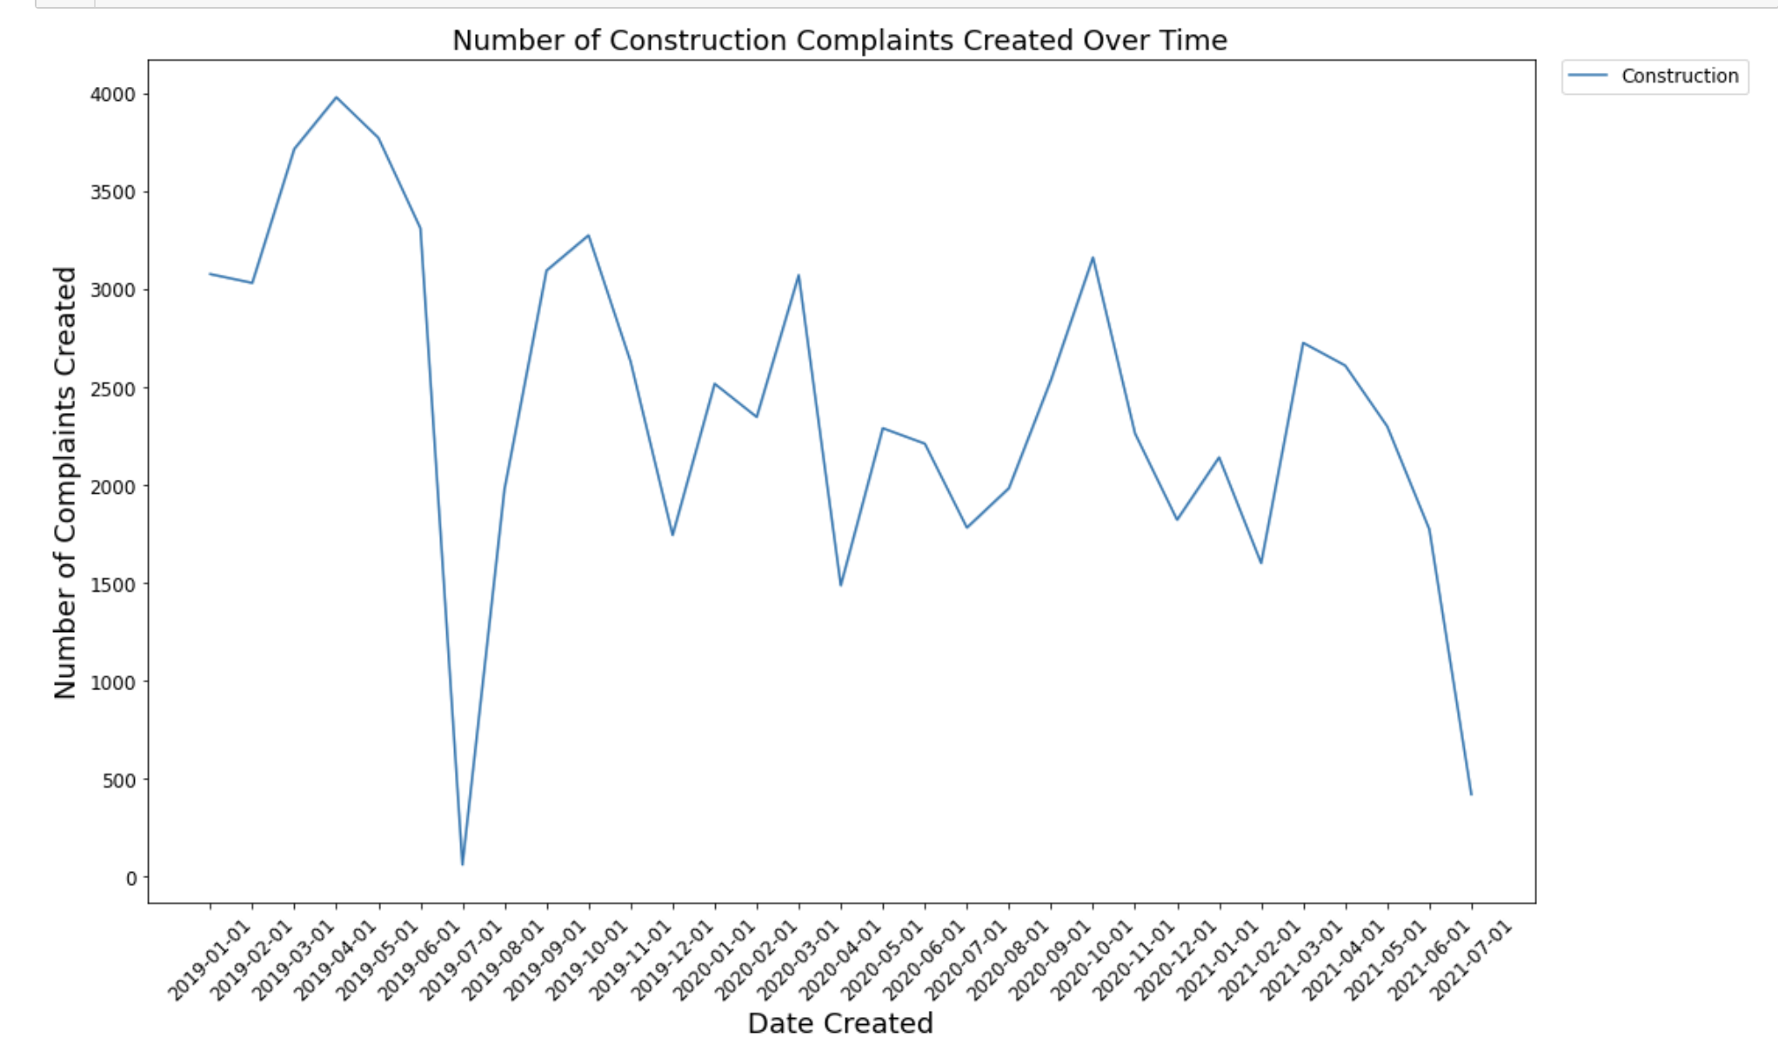
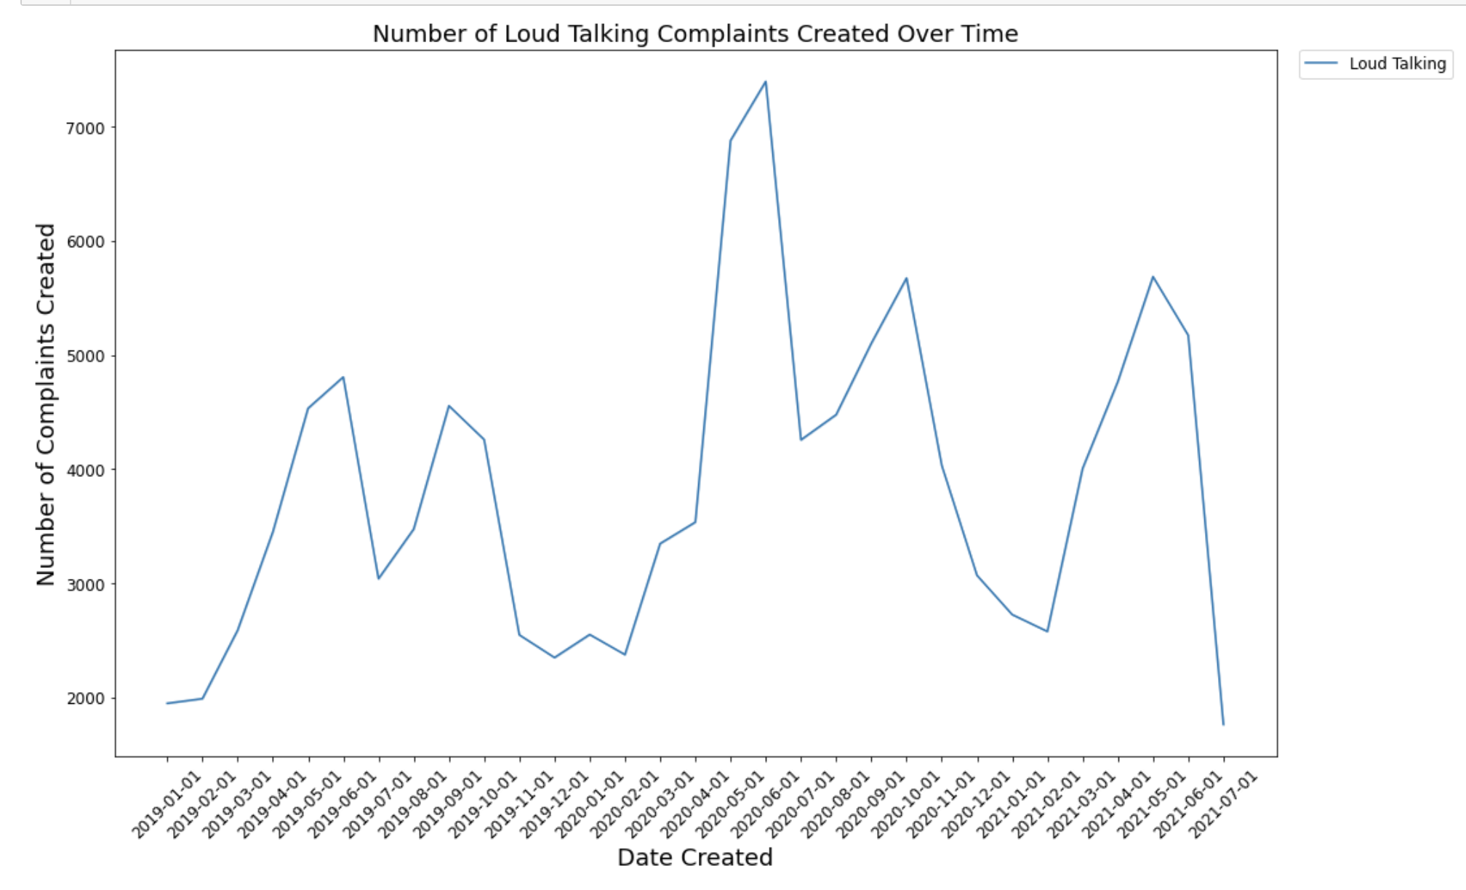
Noise Complaints by Descriptor

Slide 12
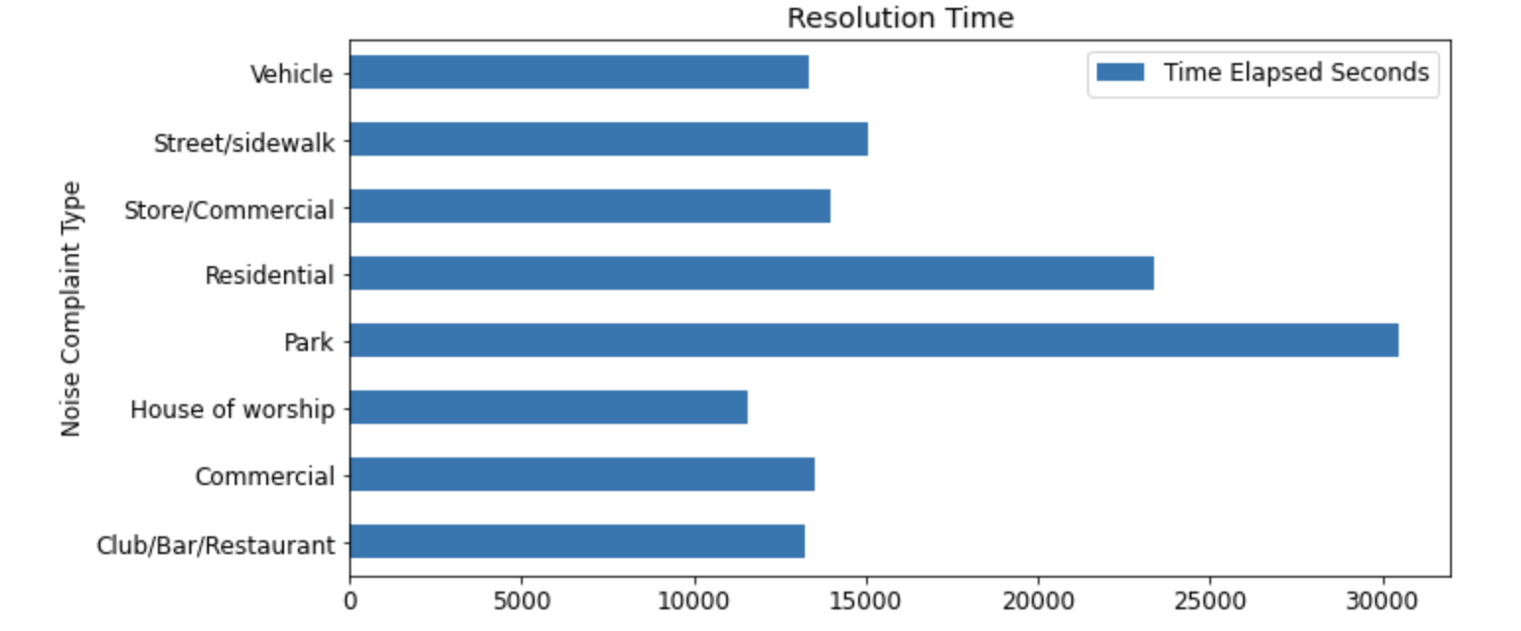
Complaint Resolution Time

Slide 13
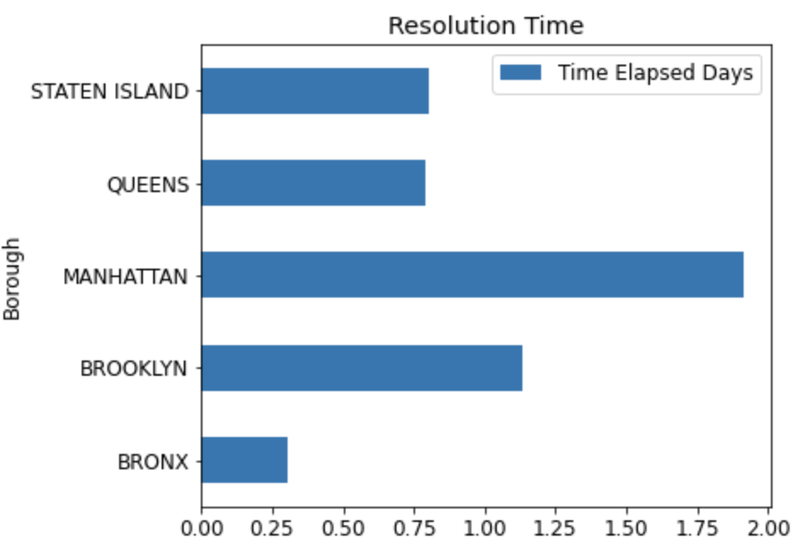
Complaint Resolution Time

Slide 14
Concluding Remarks
The analysis of complaints data allows for deeper understanding of customer behavior. 311 data is a unique data set with key insights that can guide urban planners, government agencies and residents to better understand the issues and solutions available in NYC.
Noise is the number one issue in this dataset, however, as the analysis reveals, each noise subset trends differently with time.
Pre-pandemic and pandemic data indicates noise complaints fluctuated with government policies on reopening. Further investigation may be warranted so see if this data can be used a proxy for quality of life.
Response time is a valuable metric to gauge agency performance and responsiveness, according to complaint type and location.
Future work will include an analysis of complaints by location, as the data incorporates geo validated fields that allow for granular comparison.

